Slide 1
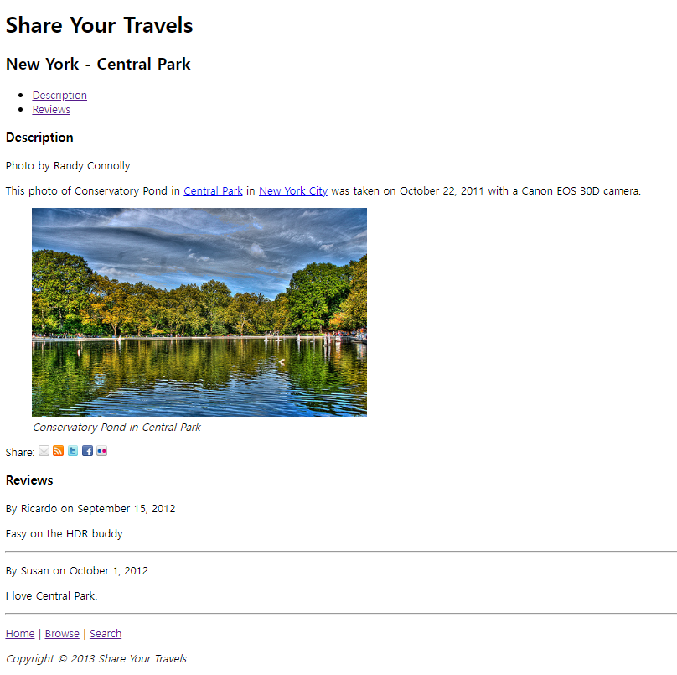
Project 1 (Lab 01): Share Your Travel Photos
Summary
A small project to create a web site for sharing the travel photos
Template is available on Plato

Slide 2
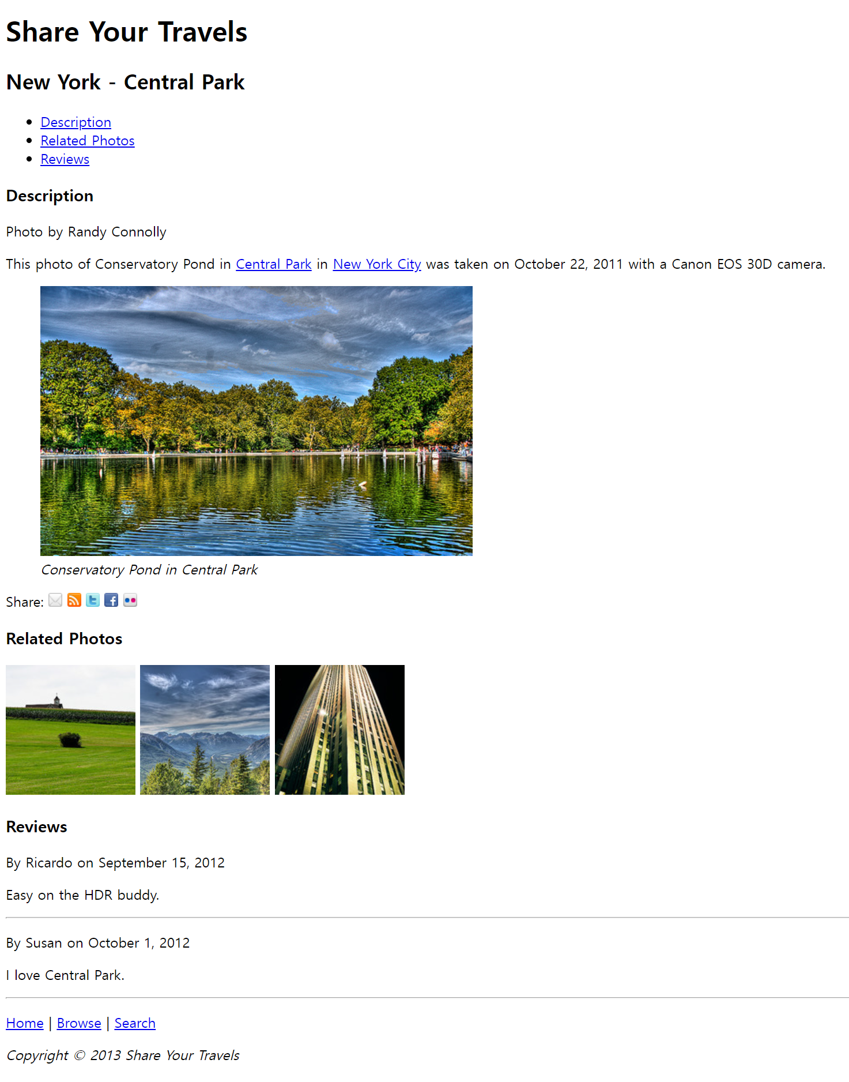
Project 1 (Lab 01): Share Your Travel Photos
Goals
Add a <nav> tag, including an unordered list to display the links to Description, Related Photos and Reviews in the same page.
Add the Central Park image (images/central-park.jpg) and add a caption as shown on the left. When adding the image, use <img> tag and add alternative text and title by using the related properties.
Inside <section>, place the small-sized images side-by-side, and when each is clicked, display its larger image. The way of displaying the larger image is up to you. The name of the small image is images/related-squareX.jpg (X=1,2,3), and the name of large image is images/related-largeX.jpg (X=1,2,3). To add small-sized images, use <img> tag, and also add alternative text and title by using the related properties for each image.
<<= Goal 1
<<= Goal 2
<<= Goal 3
Your implementation must look the same as the captured screenshot on the left including contents, layouts, etc.

Slide 3
Assignment
Lab 01
1st deadline : by the end of the class (9/19 Tue, 14:45)
2nd deadline : in seven days after the class (~9/25 Mon, 23:55)

